Slide 1


3 – GIT, the Version Control System
Robotics and Computer Vision (BPC-PRP)
Couse supervisor: Ing. Adam Ligocki, Ph.D.
Slides:Ing. Adam Ligocki, Ph.D.
Brno University of Technology
2025

Slide 2
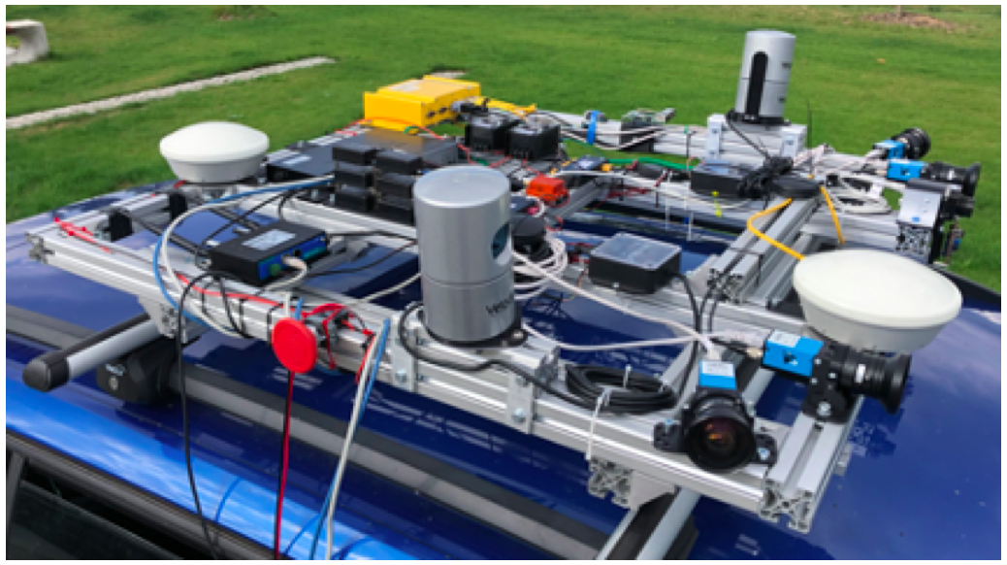


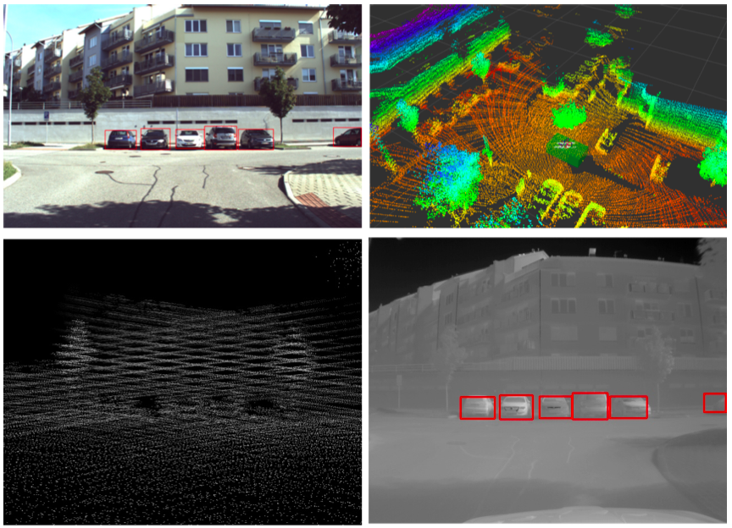

Profile
Ing. Adam Ligocki, Ph.D.
Position: Research Staff
Research: Data Fusion
Room: SE1.102
Web: https://www.vut.cz/lide/adam-ligocki-154791
Background:
Artificial Intelligence
Neural Networks
Software Development

Slide 3
Git – Distributed System for Version Control

Slide 4


GIT Basics
System for versioning the source codes (generally any text sources).
Allows to track changes in the project during the time (who and when made which change).
Keeps backup of the project.
Allows multiple developers collaboration.

Slide 5
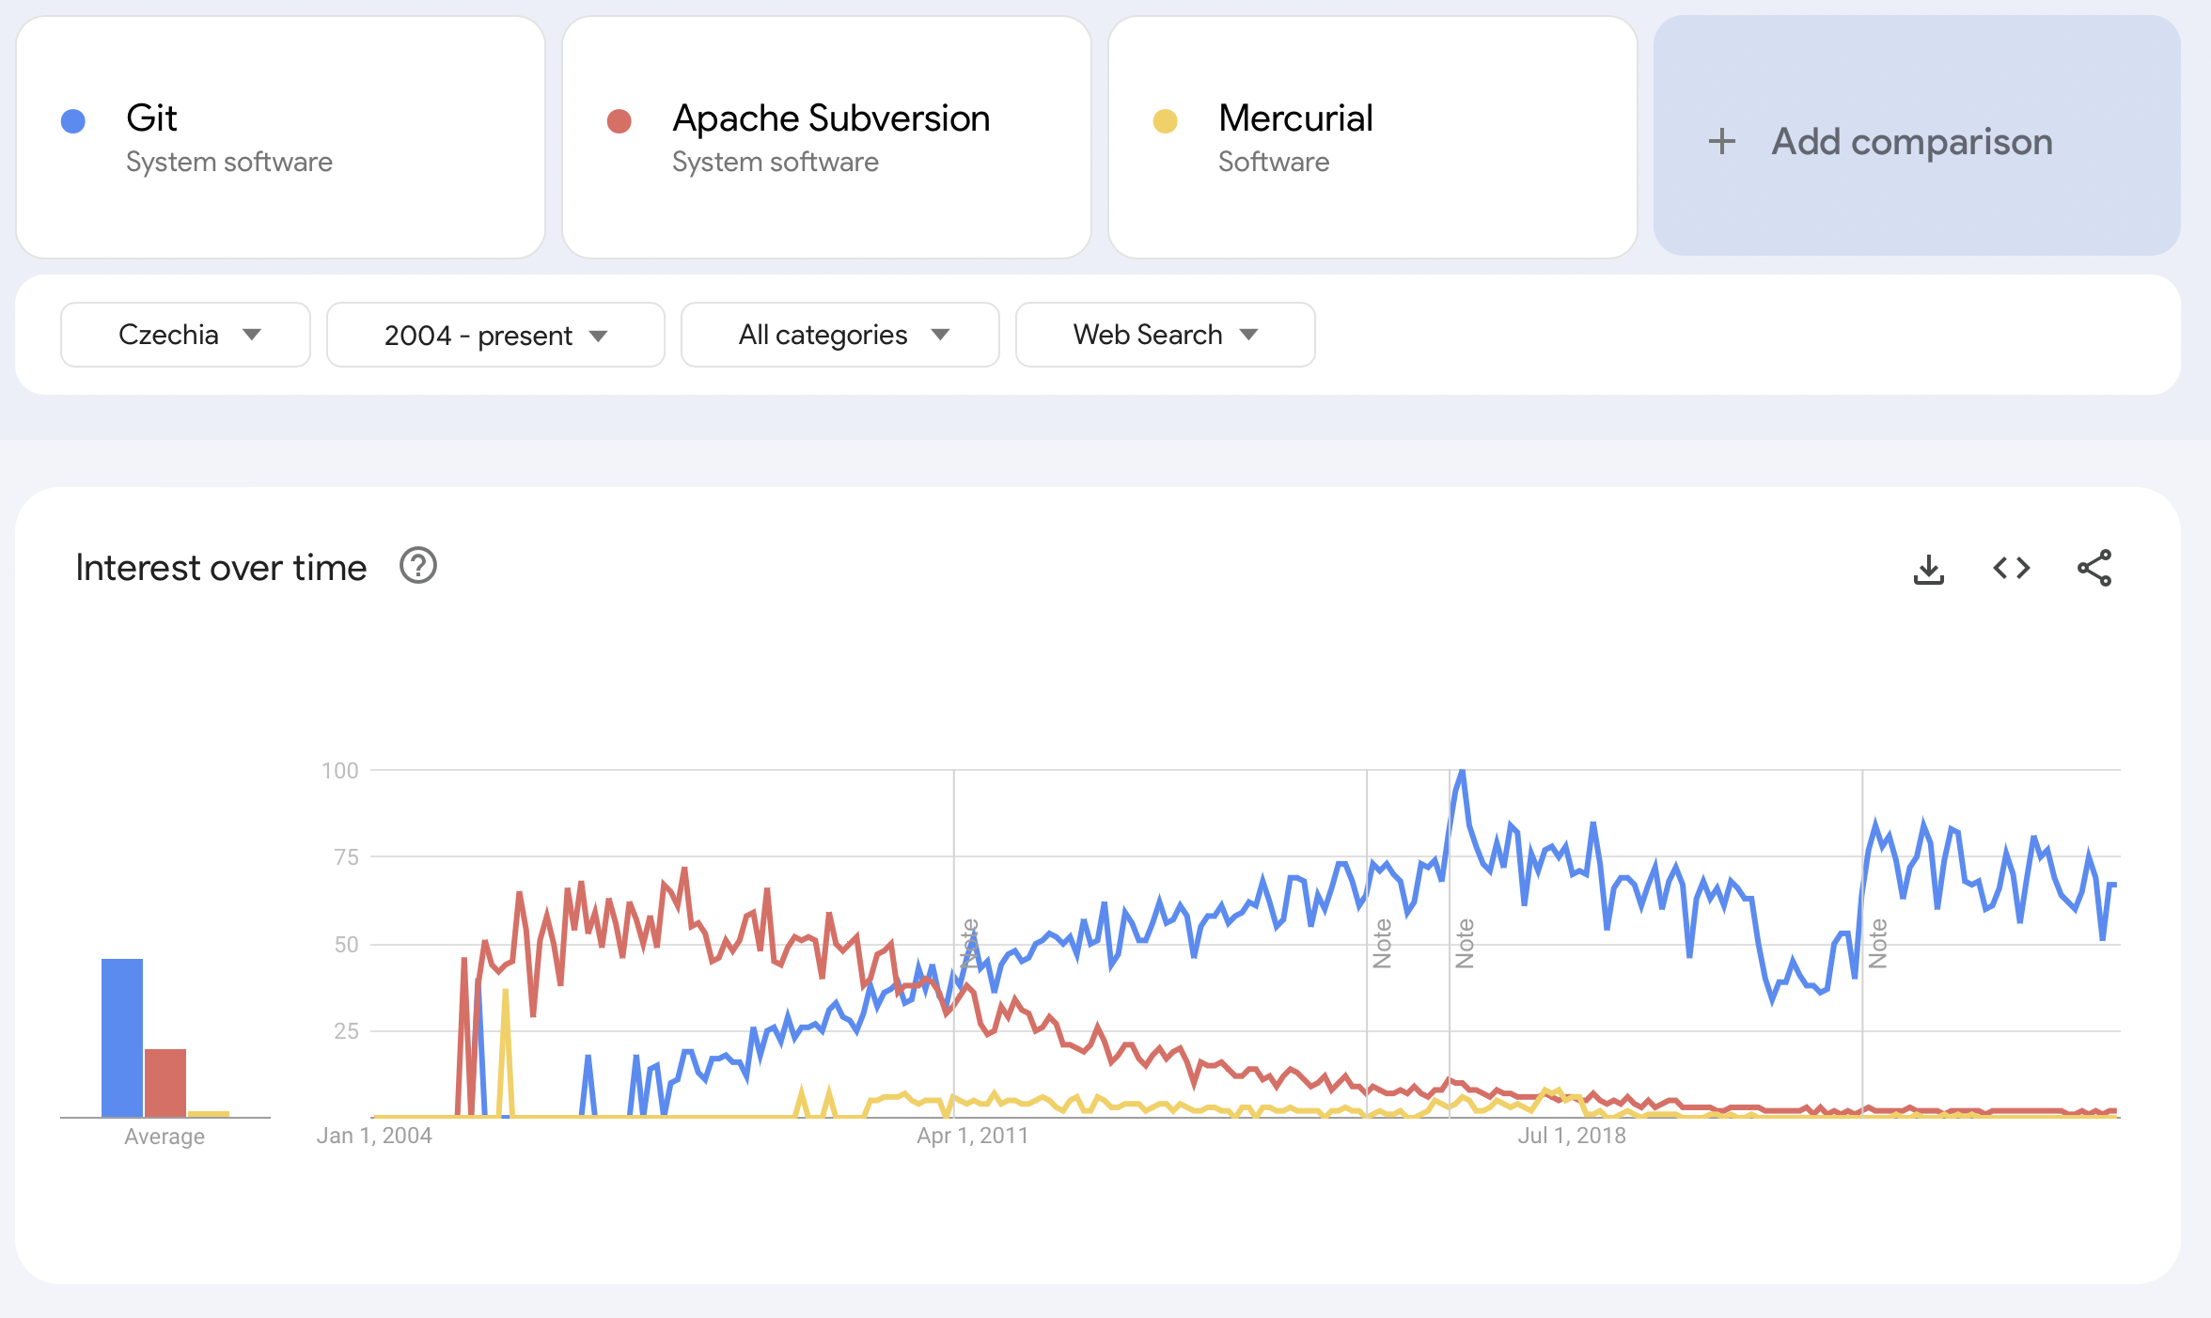
Why does GIT matter?

Slide 6

GIT Basic Terms - Commit
Snapshot - In Git, a snapshot is the full state of your repository at a specific moment. Each commit captures this state, even though Git optimizes storage by reusing unchanged files.
Commit is a Git object that encapsulates a snapshot of your repository along with important metadata. Each commit contains:
Reference to the tree
Reference to the parent
Metadata
Hash
Mr Pokee / Instagram

Slide 7
GIT Basic Terms - Repo
Repository (repo) is a collection of files and their complete history managed by Git. This includes all the commits, branches, and tags that represent changes over time.
A Repository can exist on your local computer (local repo) or on a remote server (remote repo). While "origin" is often used as the default name for a remote repository when you clone a repo, it’s simply a convention.
Cloning is the process of copying an entire repository, including its history, from a remote location to your local machine.
Pulling downloads commits from the remote repository and integrates them into your current branch. Technically, a pull is a combination of a fetch (downloading the commits) followed by a merge (integrating the commits).
Pushing is the act of uploading your local commits to a remote repository, updating it with your changes.

Slide 8
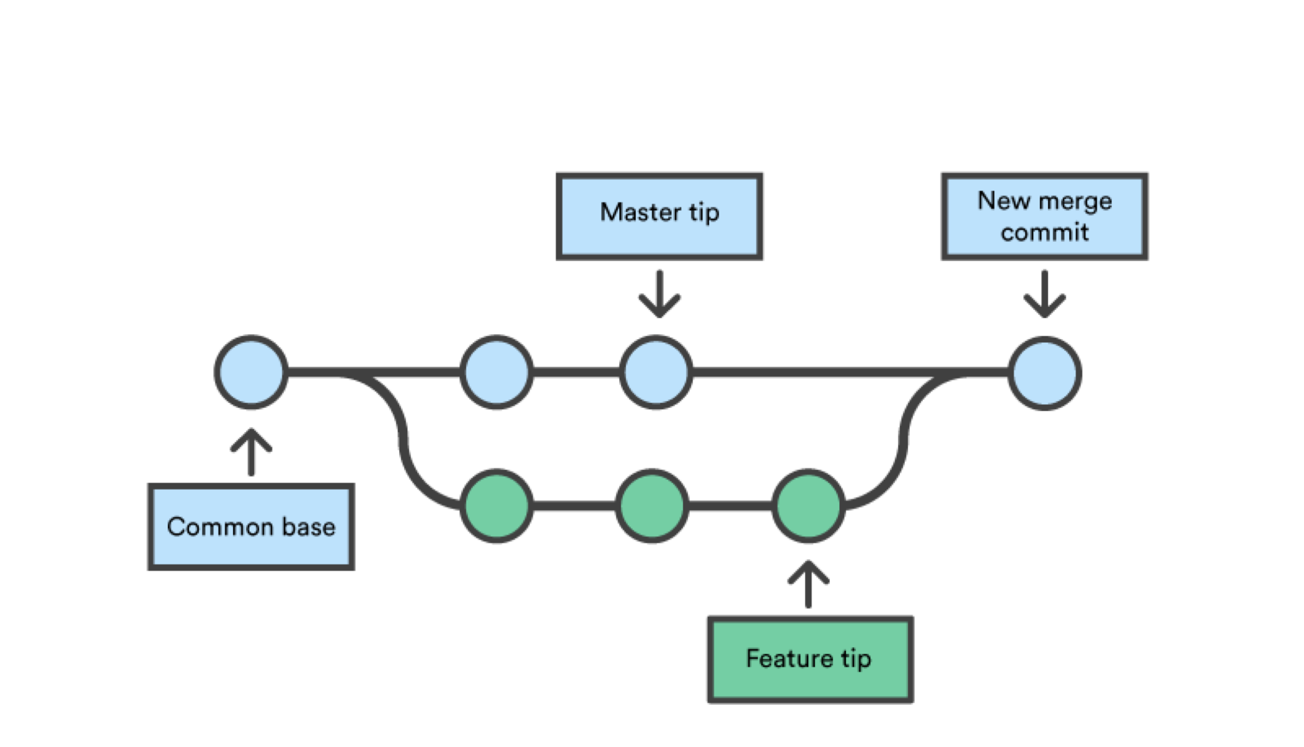
GIT Basic Terms - Branch
All commits in Git are organized into branches. A repository starts with a default branch (usually called master or main).
Branching lets you work on features independently, and merging brings those changes together into one branch.
https://www.atlassian.com/git/tutorials

Slide 9
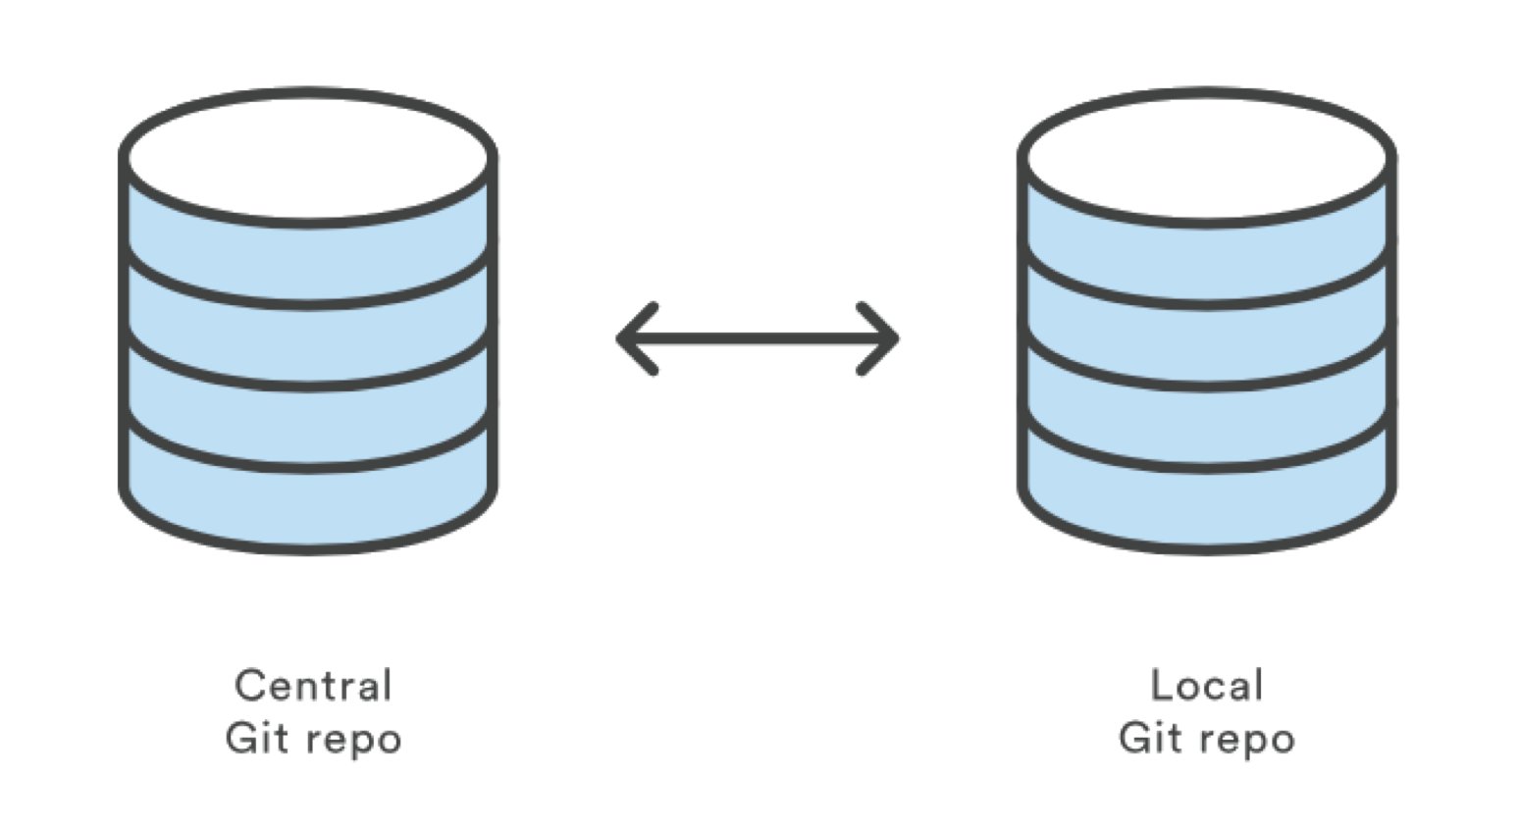
GIT – Basic Idea
You write your code and, after completing each small task, you save your changes (diff) with a commit in your local repository.
Once a larger feature is complete, you push your commits to a remote repository (commonly called origin), where other developers can pull and integrate them.
https://www.atlassian.com/git/tutorials

Slide 10
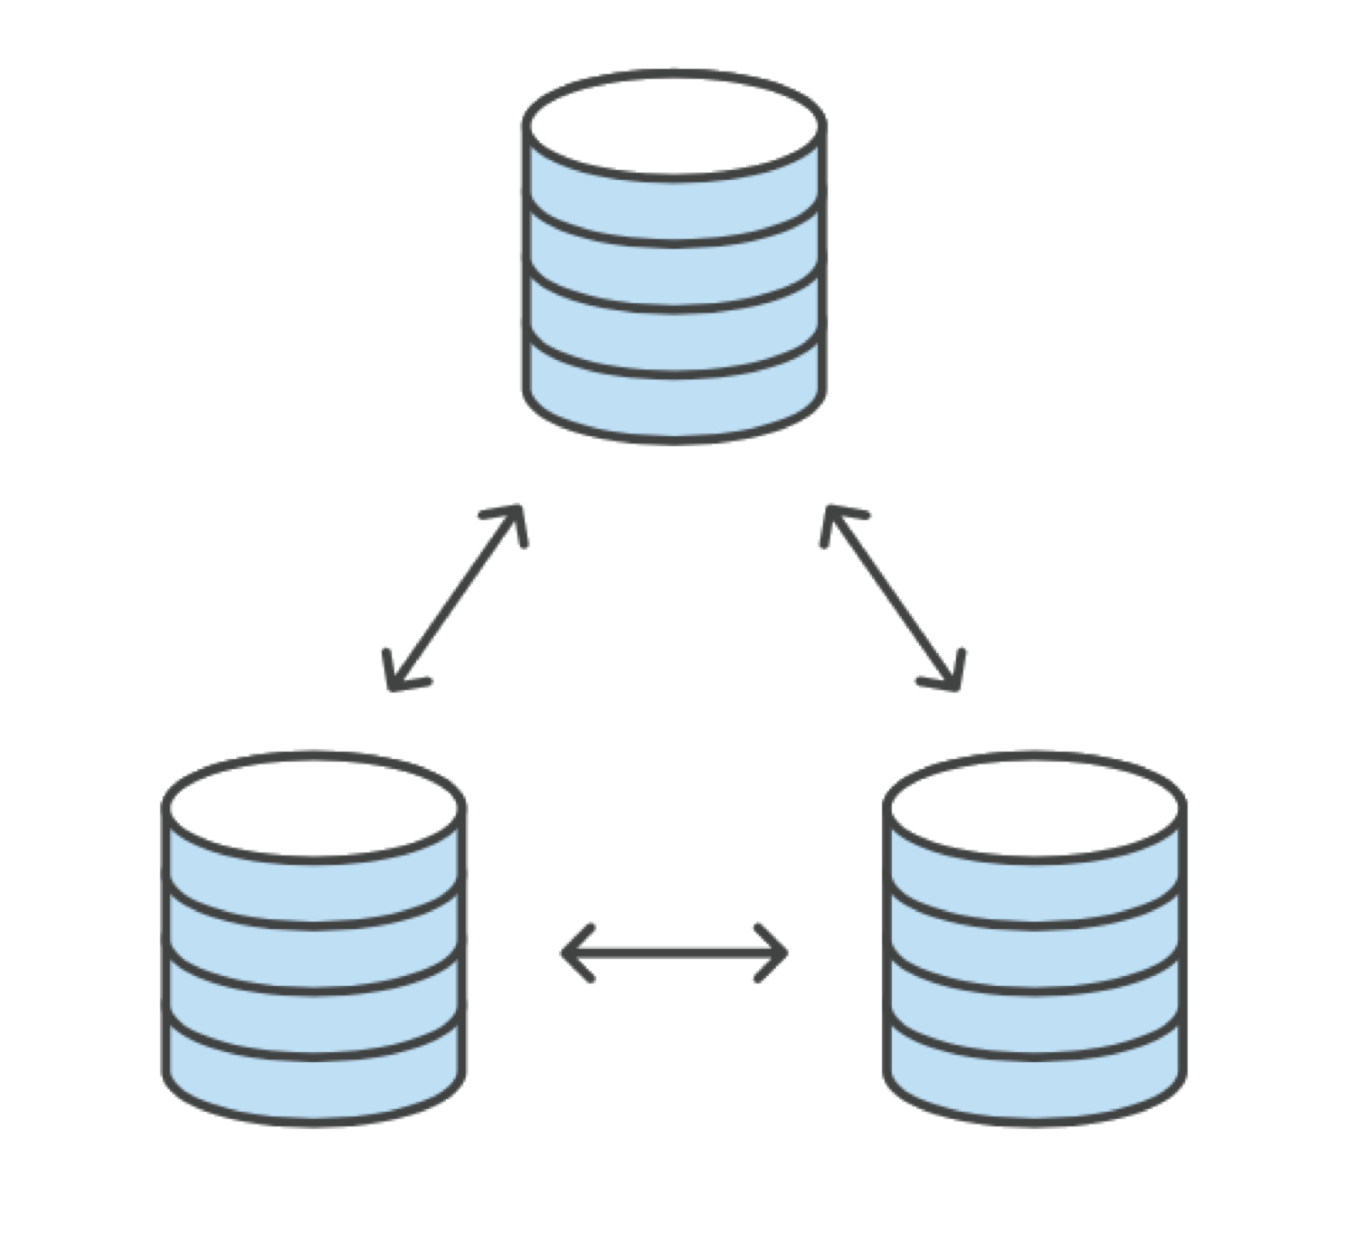
GIT – Distributed System
Git is fully decentralized, meaning every repository can be a complete copy of the entire project, including all branches and history.
This redundancy ensures that if a server fails, any repository can restore the complete history.
https://www.atlassian.com/git/tutorials

Slide 11
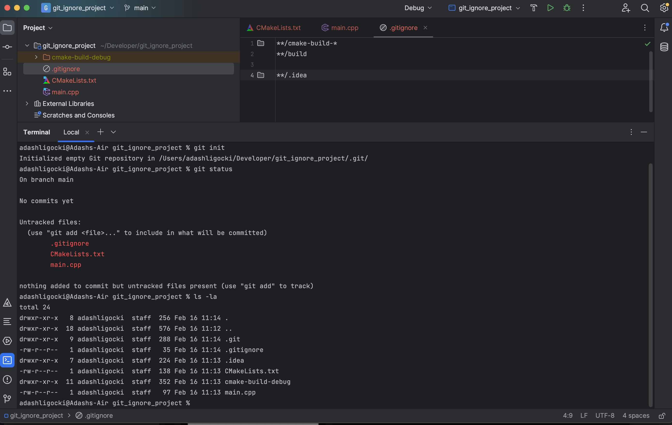
.gitignore File
File that defines files or folders that GIT should ignore
Typically the caches, build dependent files or binaries
Never commit binaries into GIT!
For .gitignore templates see:
https://github.com/github/gitignore
or
http://gitignore.io

Slide 12
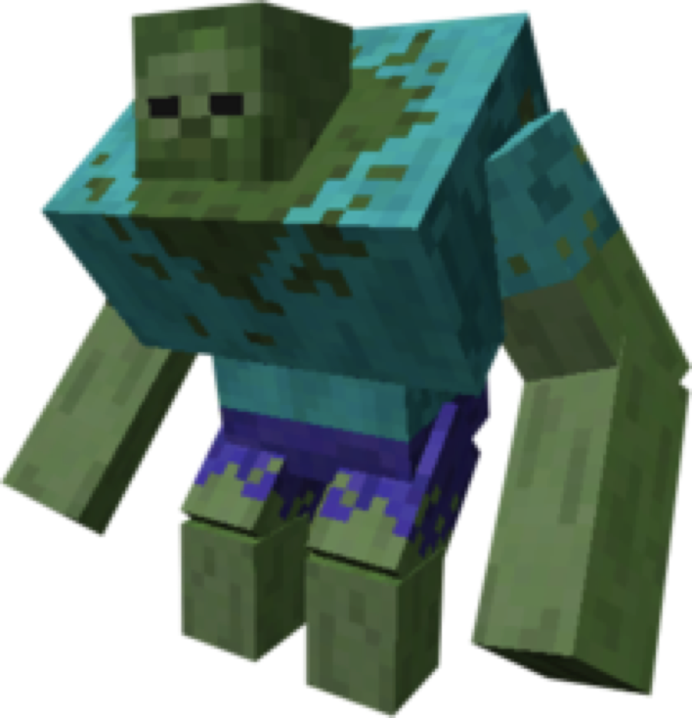
GIT – Large Files
Git works well for the text file version control. It tracks newly added, deleted, or modified lines of text (source code)
Git is not able to effectively follow changes in the binary files (exec, libraries, compressed files, etc …) or the automatically generated files (the build/ folder)
Use .gitignore file in the root of the repository to exclude redundant files.
For large files in git, see Large File Storage (LFS)
Minecraft Wiki

Slide 13
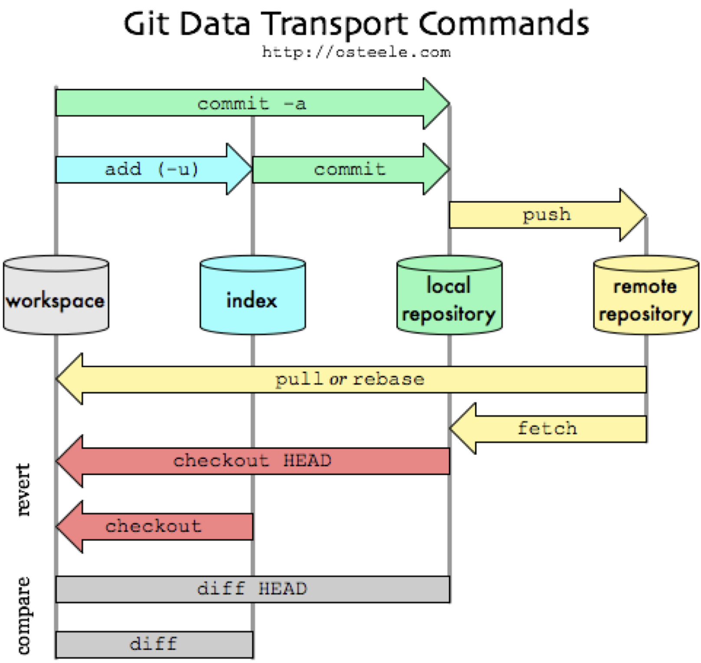
GIT - Workflow
https://medium.com/@chonglee30/git-overview-30618e81eb77

Slide 14
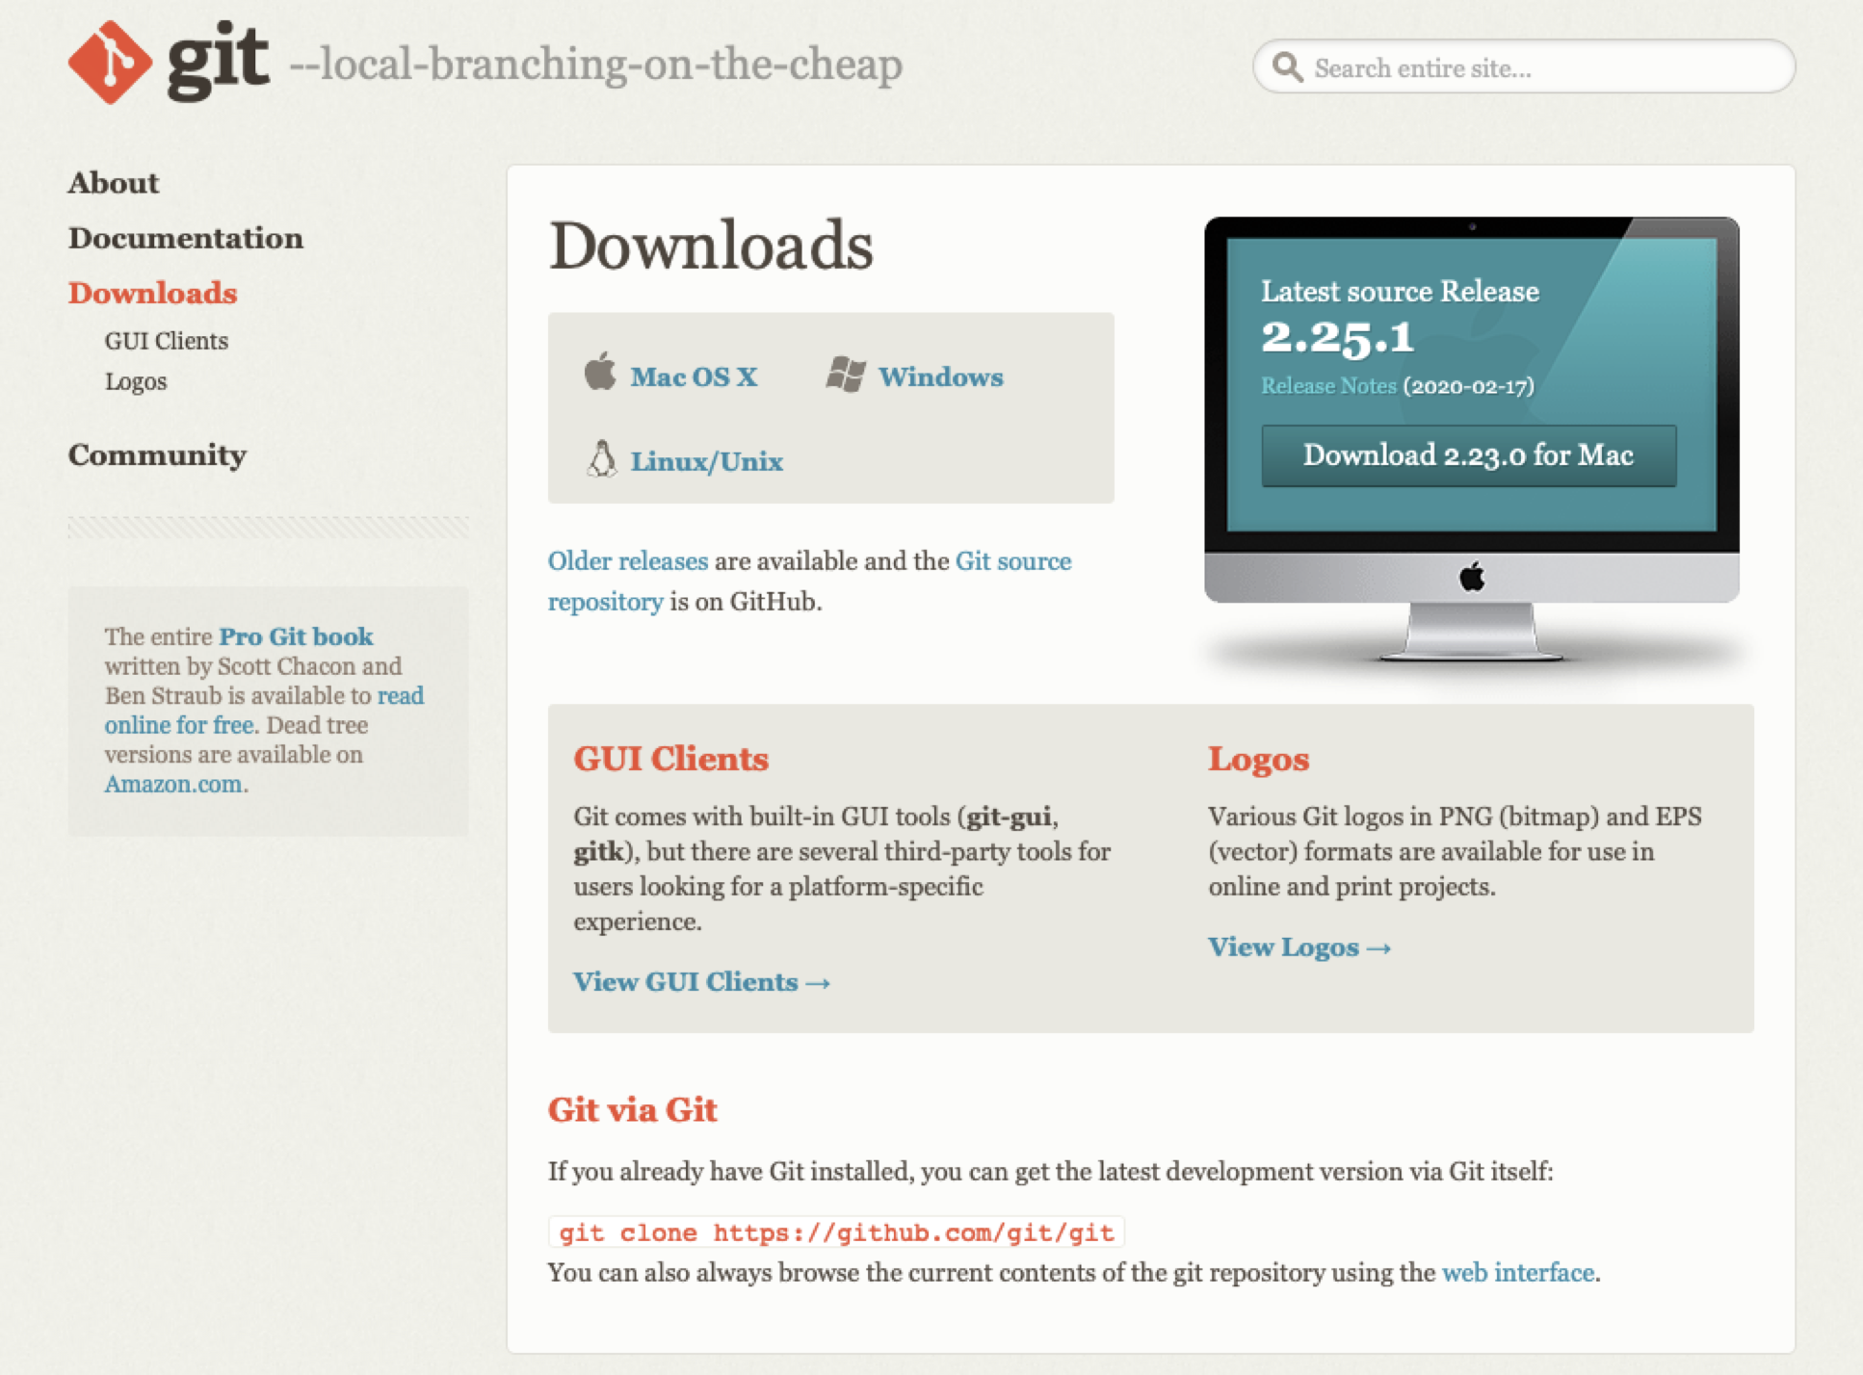
GIT - Intallation
Git is an open-source project, and it is provided as a precompiled binary for all three major OS platforms
On Debian Linux dist. use: sudo apt install git
For details see the official web:
https://git-scm.com/downloads

Slide 15

GIT – Commands Overview
git init - initialize local repository in the local directory, where your project is located
git add - this command adds files to the index (now the changes are accepted and waiting to be committed)
git commit - saves the staging changes to the local repository each commit has a unique SHA-1 20-byte hash that works as an alias
git clone - downloads an identical copy of the remote repository to your computer
git push - sends all the new commits from your local repository to the remote repository
git pull - downloads new commits from remote repository to the local repository
git remote - command for configuring connection with a remote repository
https://unsplash.com/s/photos/cute-cat

Slide 16

GIT – Commands Overview
git diff - shows all the changes in the working directory that has not been added to the index yet
git status - printout the status of the repository
git log - simple visualization of the repository history
git stash - saves your current changes and cleans working directory
git branch - allows you to create separated branches, where you can develop independent features
git merge - combines some branch with the current one
git checkout - switch your repository to the sate that corresponds with the given commit (hash)
checkout allows you also to switch between branches
https://www.pexels.com/search/cute%20puppy/

Slide 17


GIT - Conflicts
#include <stdio.h>
int main() {
return 0;
}
#include <stdio.h>
int main() {
doEvenCoolerStuff();
return 0;
}
#include <stdio.h>
int main() {
doSuperCoolStuff();
return 0;
}
#include <stdio.h>
int main() {
<<<<<<< HEAD
doSuperCoolStuff();
=======
doEvenCoolerStuff();
>>>>>>>
return 0;
}

Slide 18

GIT – Online Platforms and Services
There are several online services that provides git functionality.
Additionally, these services allow you to configure the repository, track issues, create wiki pages, perform continuous integration tests, etc.
For non-commercial usage, it is free
Can deploy GitLab on your own server

Slide 19
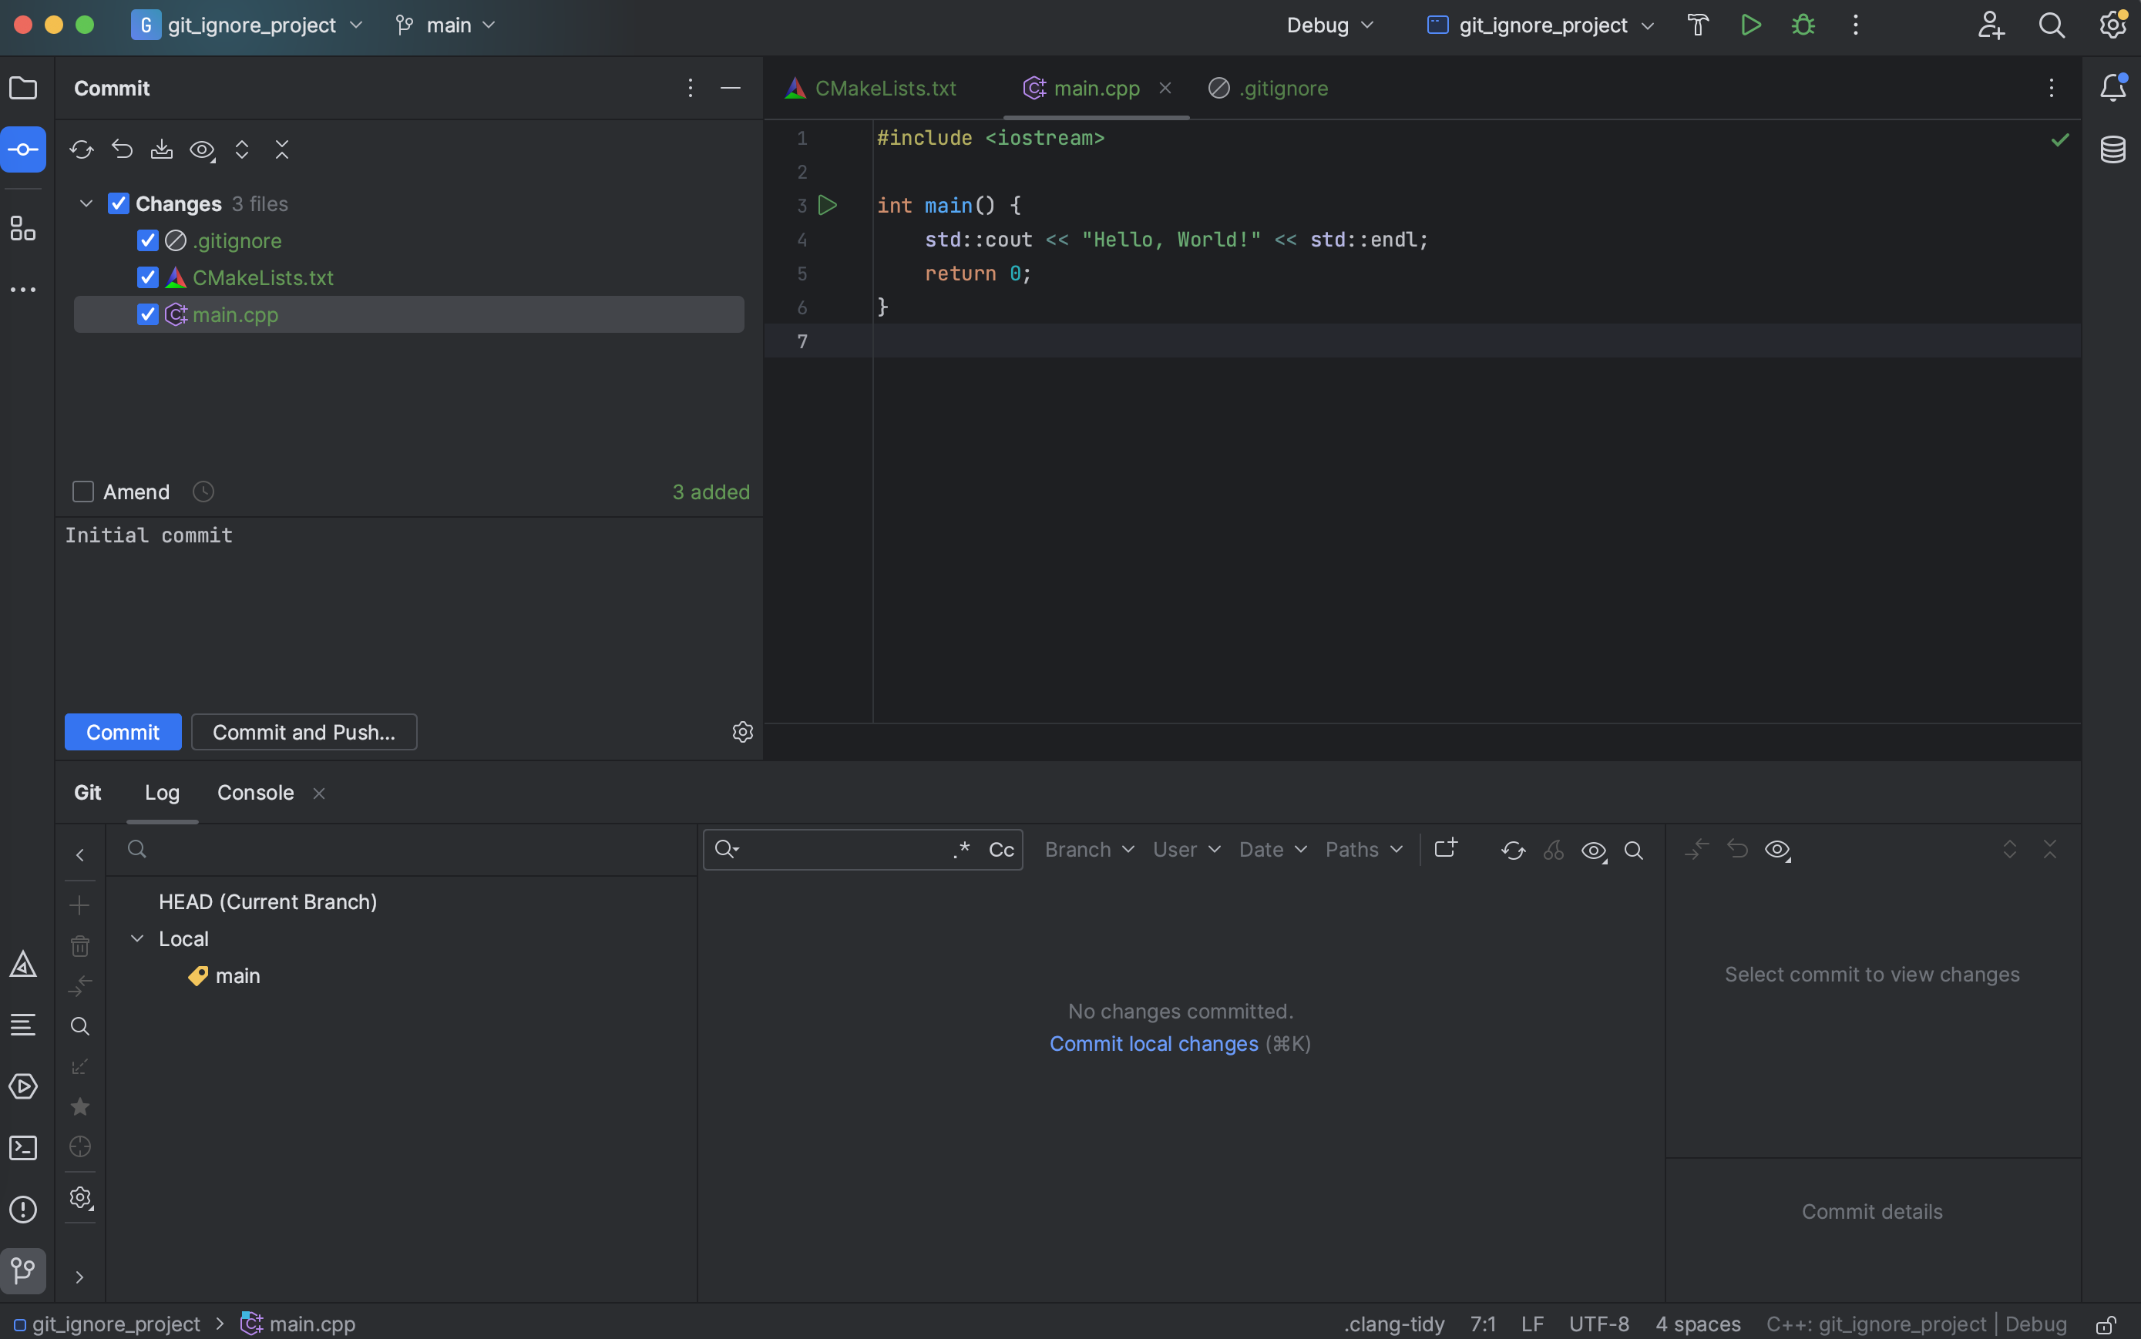
GIT – VCS integration in CLion

Slide 20
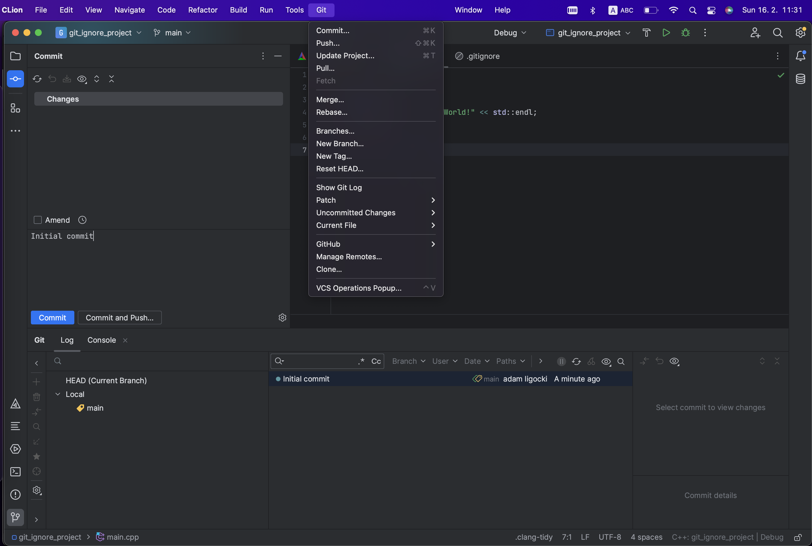
GIT – VCS integration in CLion

Slide 21
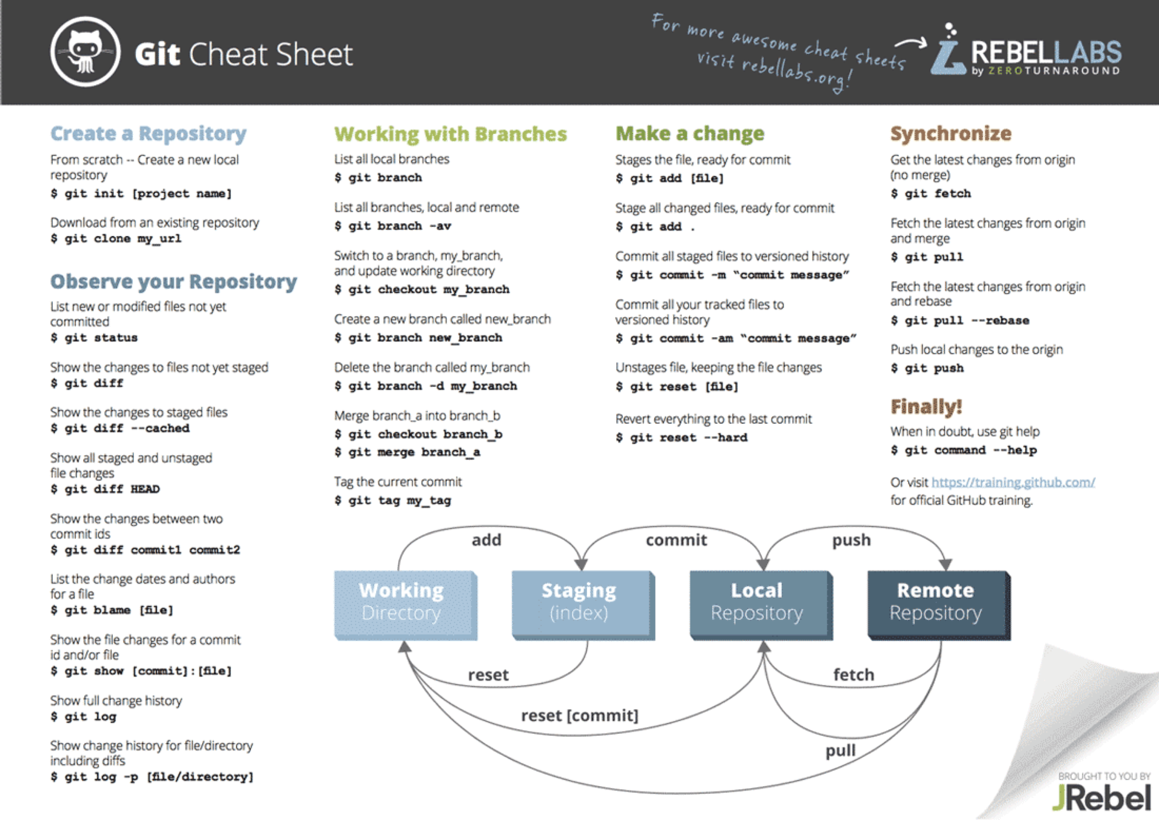
https://www.jrebel.com/blog/git-cheat-sheet

Slide 22
GIT Minimum
git init
git add
git commit
git status
git checkout
git push
git pull
.gitignore

Slide 23
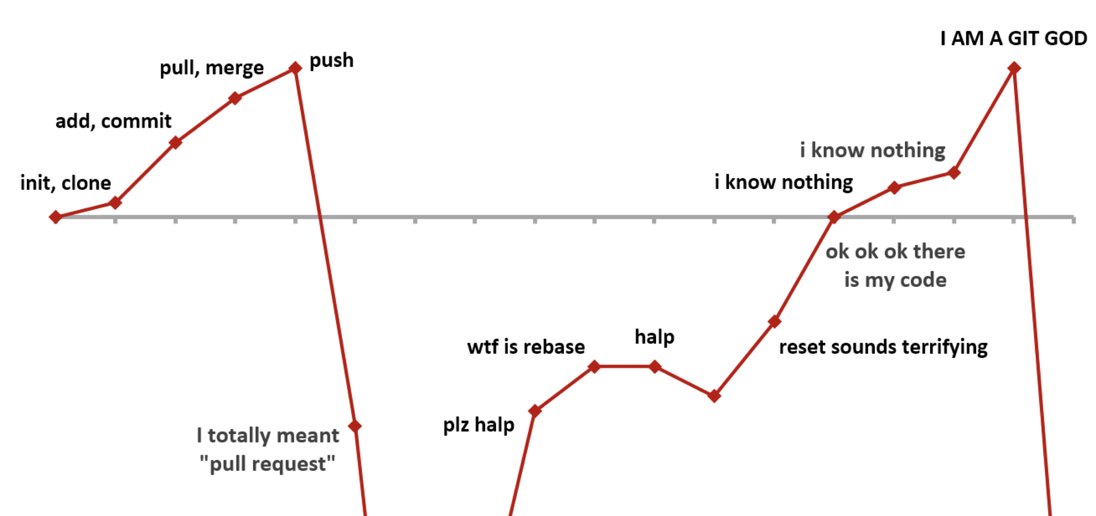
GIT - Help
Very Useful Link: https://ohshitgit.com/en

Slide 24
GIT – Next Step
[1] - Official project web: https://git-scm.com
[2] - Free book: https://git-scm.com/book/en/v2
[3] - Very nice and complex tutorial: https://www.atlassian.com/git/tutorials
[4] - Online course: https://www.udacity.com/course/version-control-with-git--ud123
[5] - Planty of YouTube video tutorial …

Slide 25
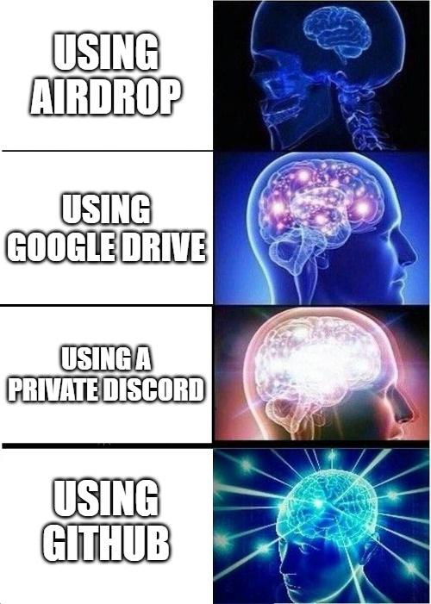
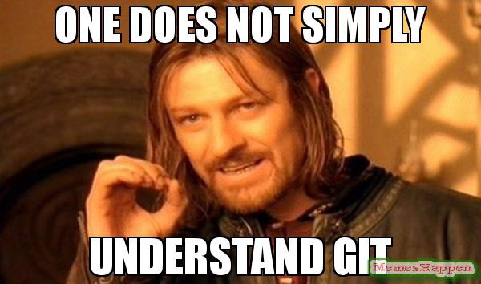
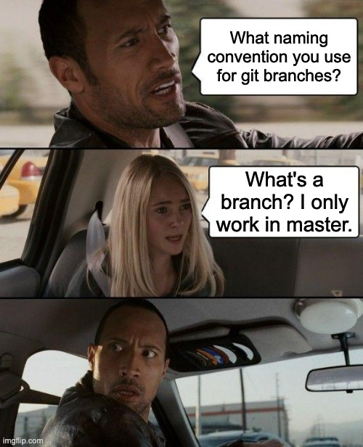
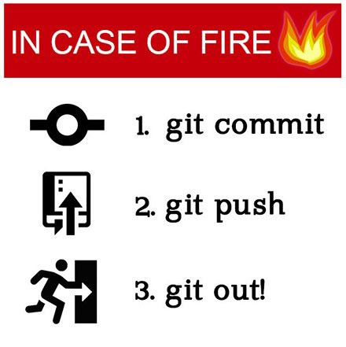
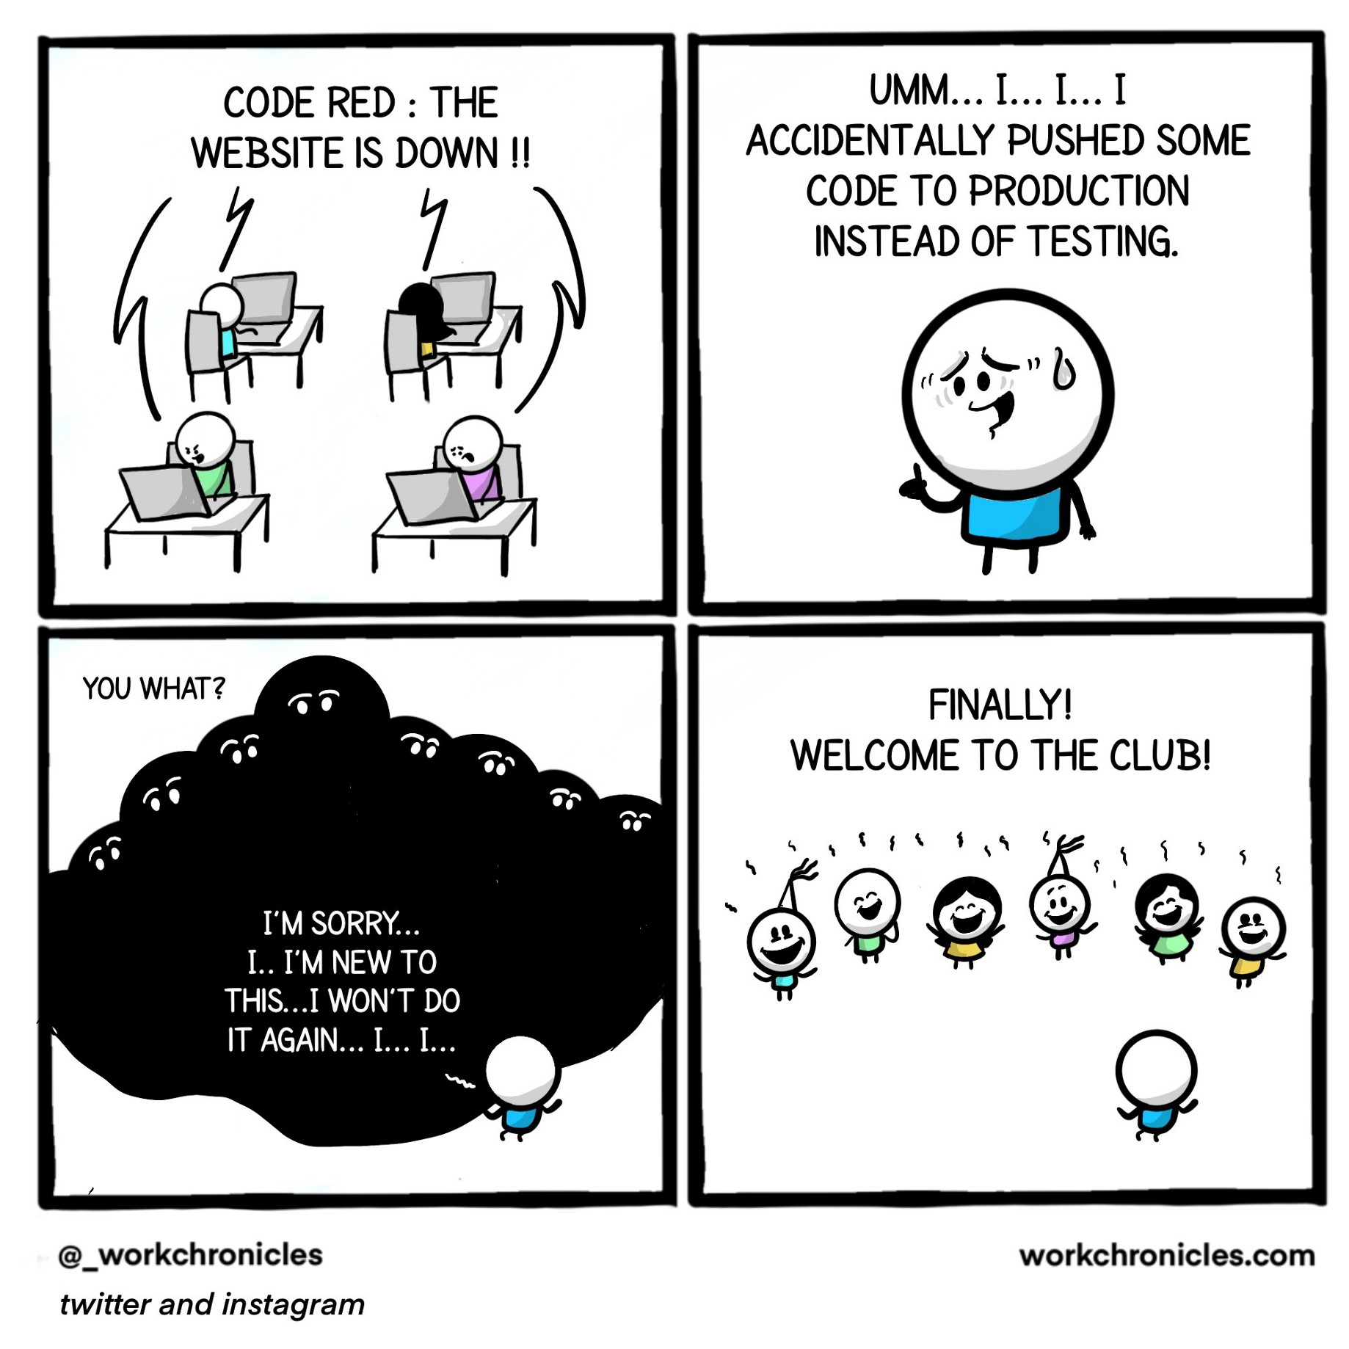
GIT – Memes

Slide 26

Adam Ligocki
adam.ligocki@vutbr.cz
Brno University of Technology
Faculty of Electrical Engineering and Communication
Department of Control and Instrumentation
Robotics and AI Research Group

